Slide 1
Interior Vehicle Monitoring System
Beatrice Smetana, Loti Ibrahimi, Justin Lizotte

Slide 2
Device Goals
To lower the amount of child vehicular fatalities each year
To prevent serious injury due to heat stroke, hypothermia, or carbon monoxide
To be a gentle reminder for parents to check the vehicle before leaving
To allow guardians to react quickly to a child left behind
To have the car take certain measures to correct an emergency situation

Slide 3
Overview
Raspberry Pi for the controller
Temperature/gas sensor to identify the cabin temperature and air quality
Heat signature sensors to identify a living being
Pressure sensors to place on/under seat area to identify the weight
Cloud will be for data storage and to send the notification to guardian or authorities
Raspberry Pi Bluetooth for parent mobile phone proximity scan

Slide 4
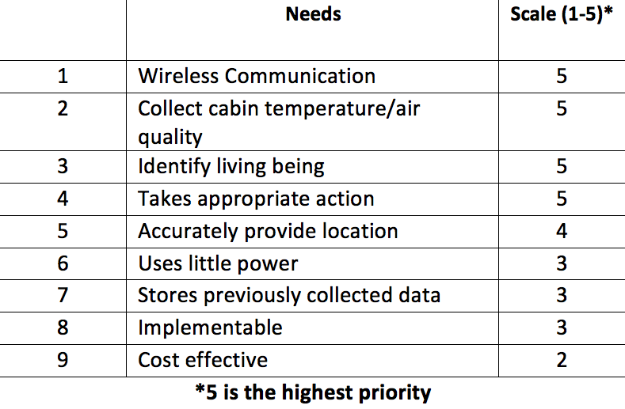

Device Requirements

Slide 5
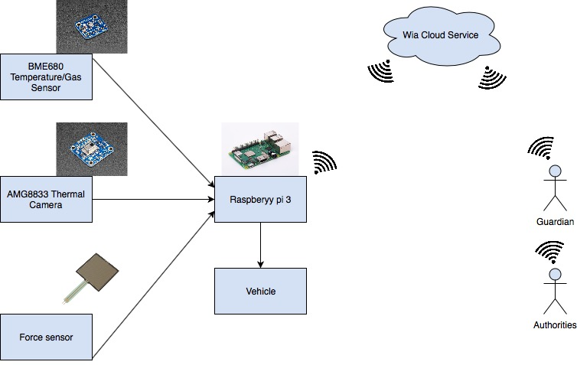

Connection of Device

Slide 6
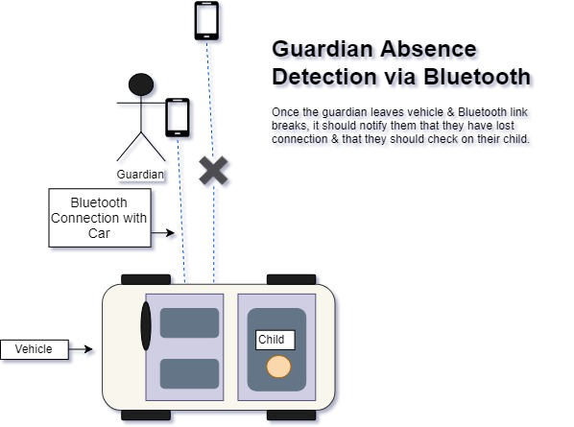
Bluetooth Detection
Two conditions
Situation under control
Parent/Guardian IS in range
Interior Vehicle Temperature at safe level
Situation Unsafe
Parent/Guardian IS NOT in range
Interior Vehicle temperature/air at unsafe level

Slide 7
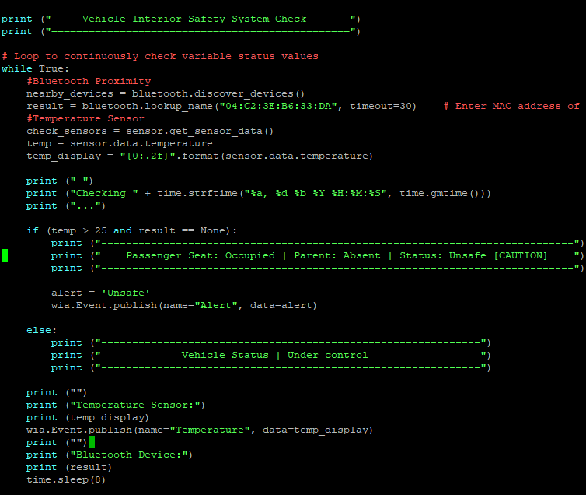
Code
Bluetooth device scan
Temperature/Gas Reading
Thermal Camera
Force Sensor
*If Parent is absent, seat is occupied, temperature > 25, Gas >100. This is UNSAFE so a Wia Event issues an alert

Slide 8
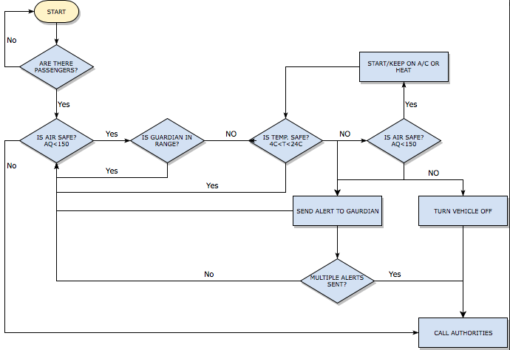
Flow of Onboard Computer

Slide 9
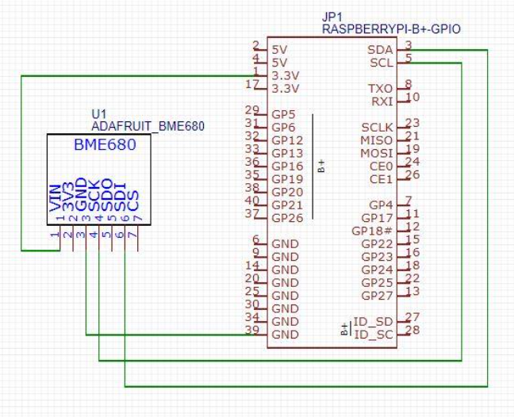
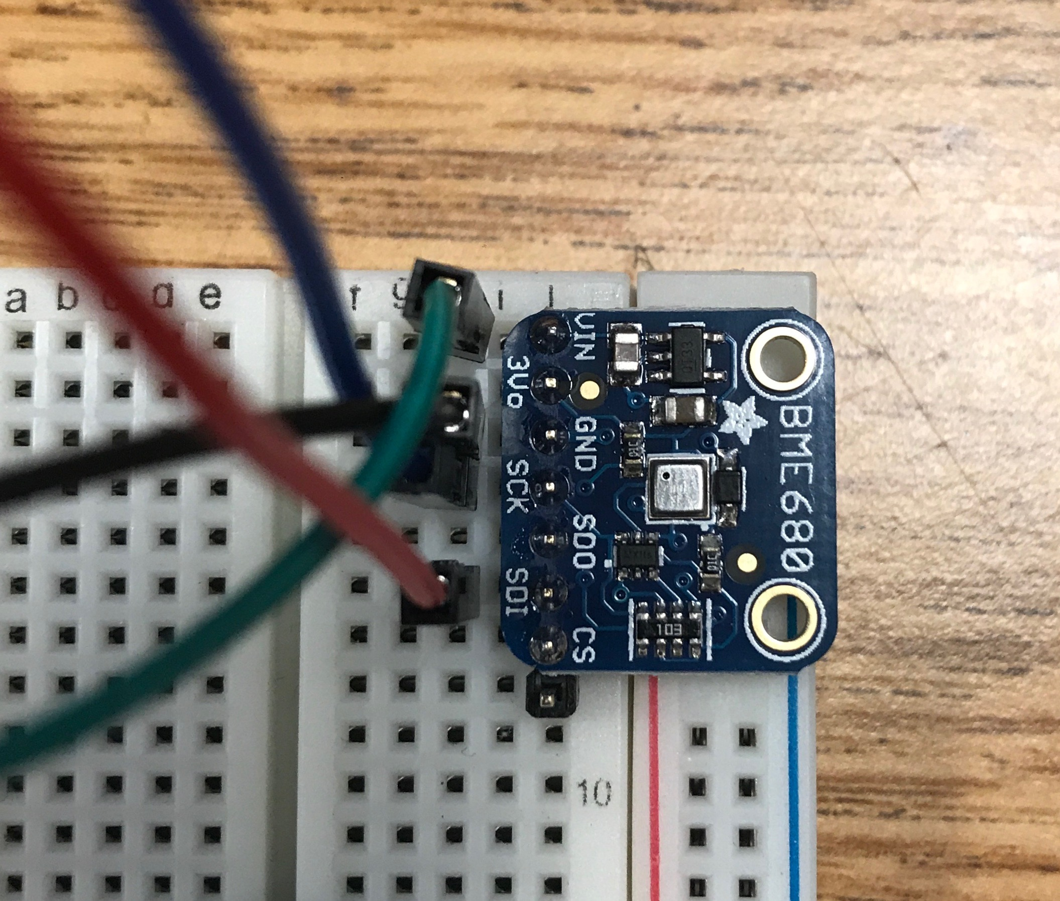
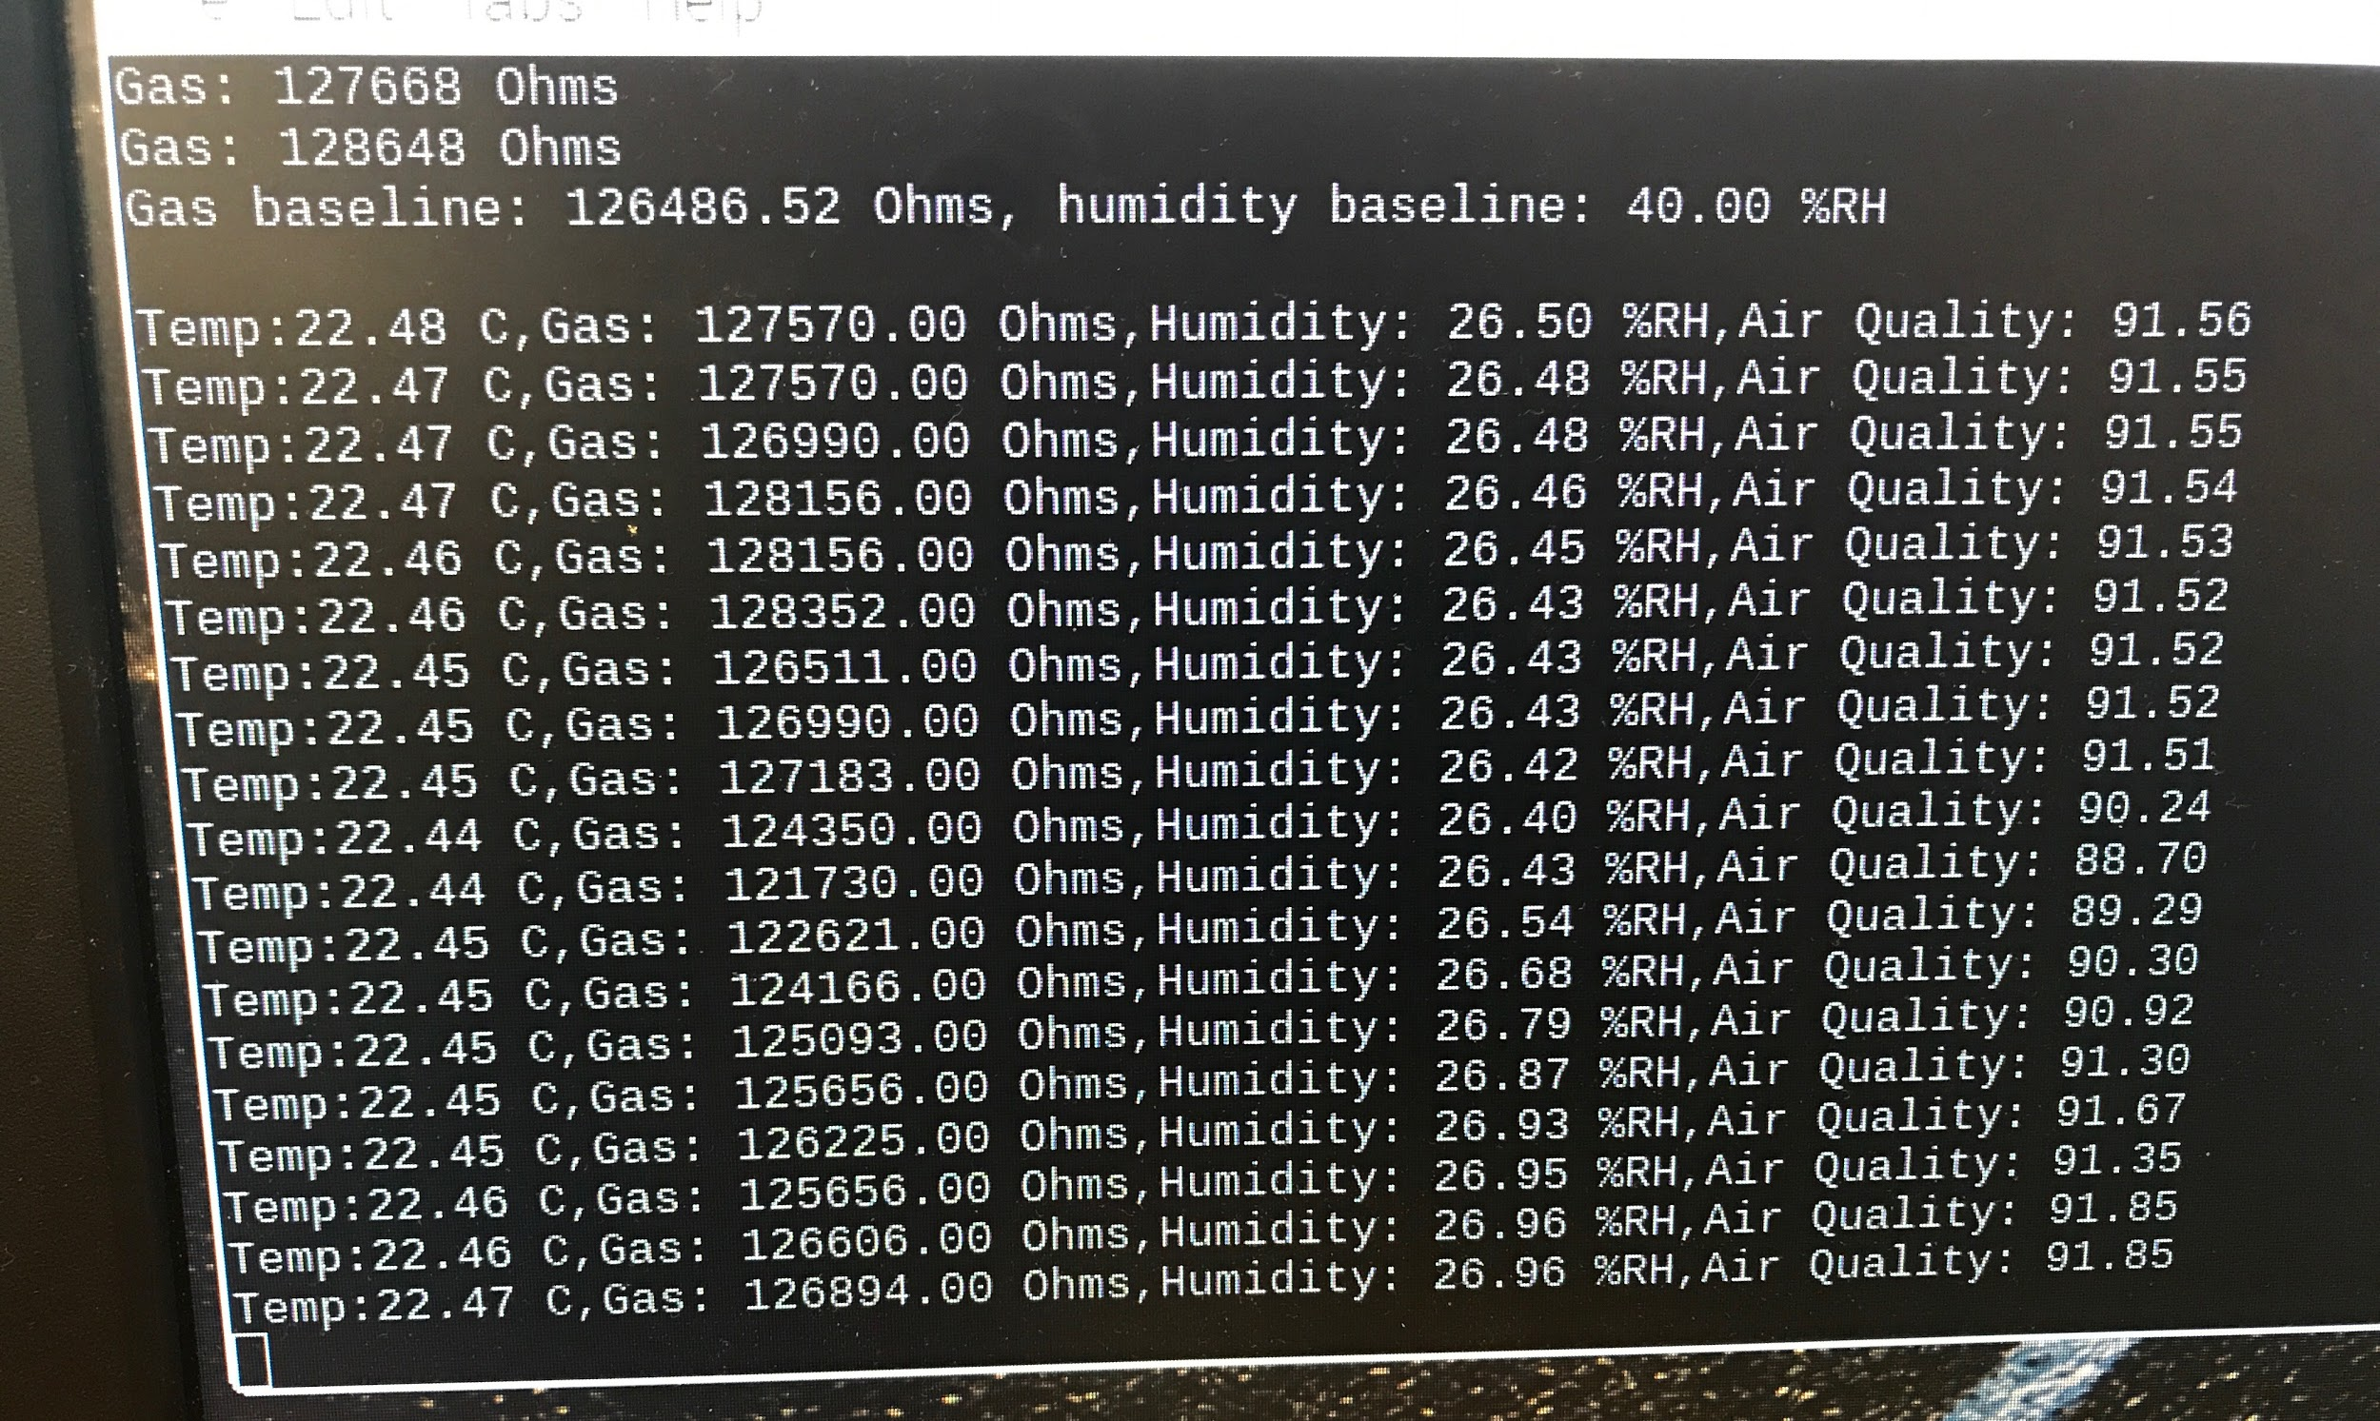
Sensors
Temperature and Gas Sensor
Schematic
Output Code
Burn in period

Slide 10
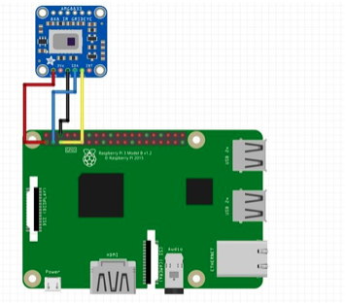
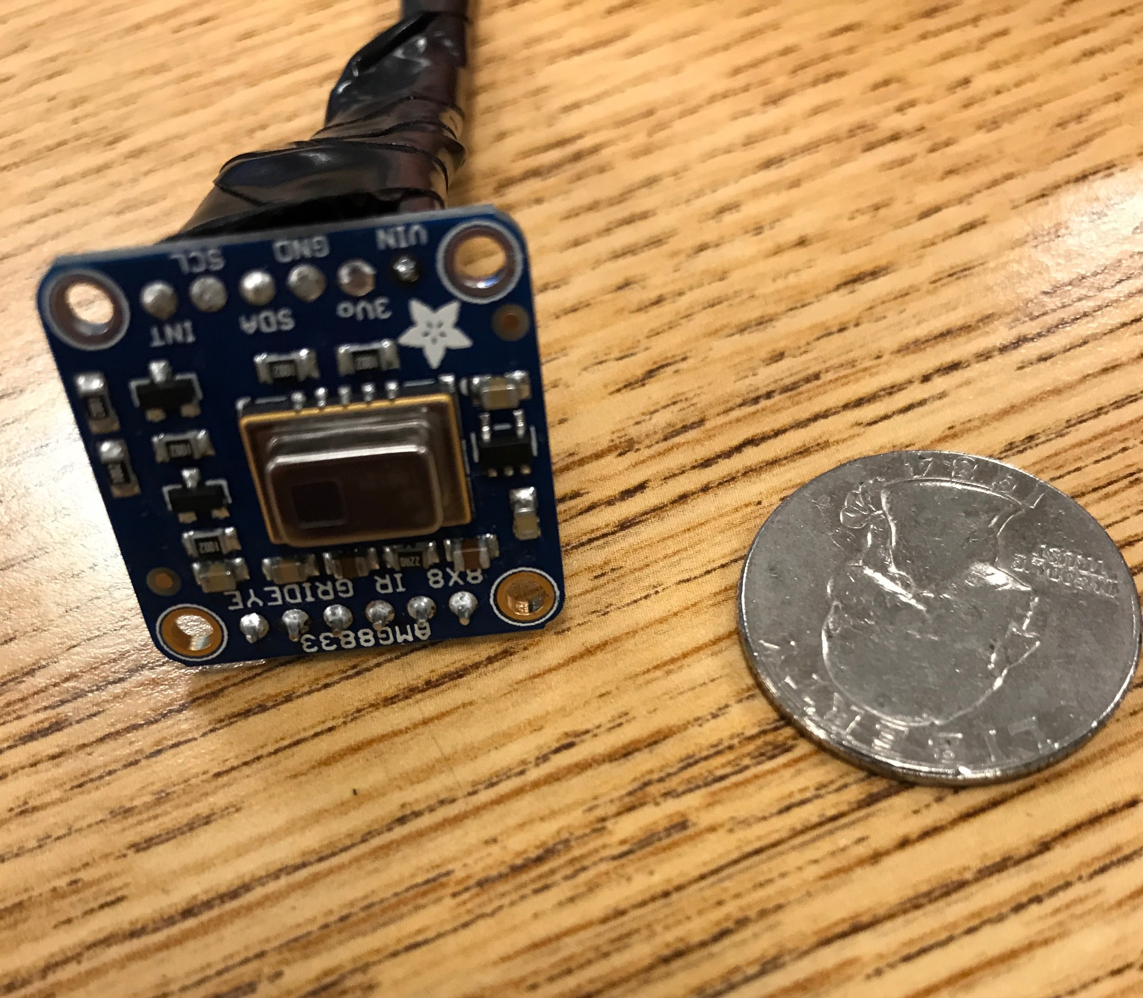
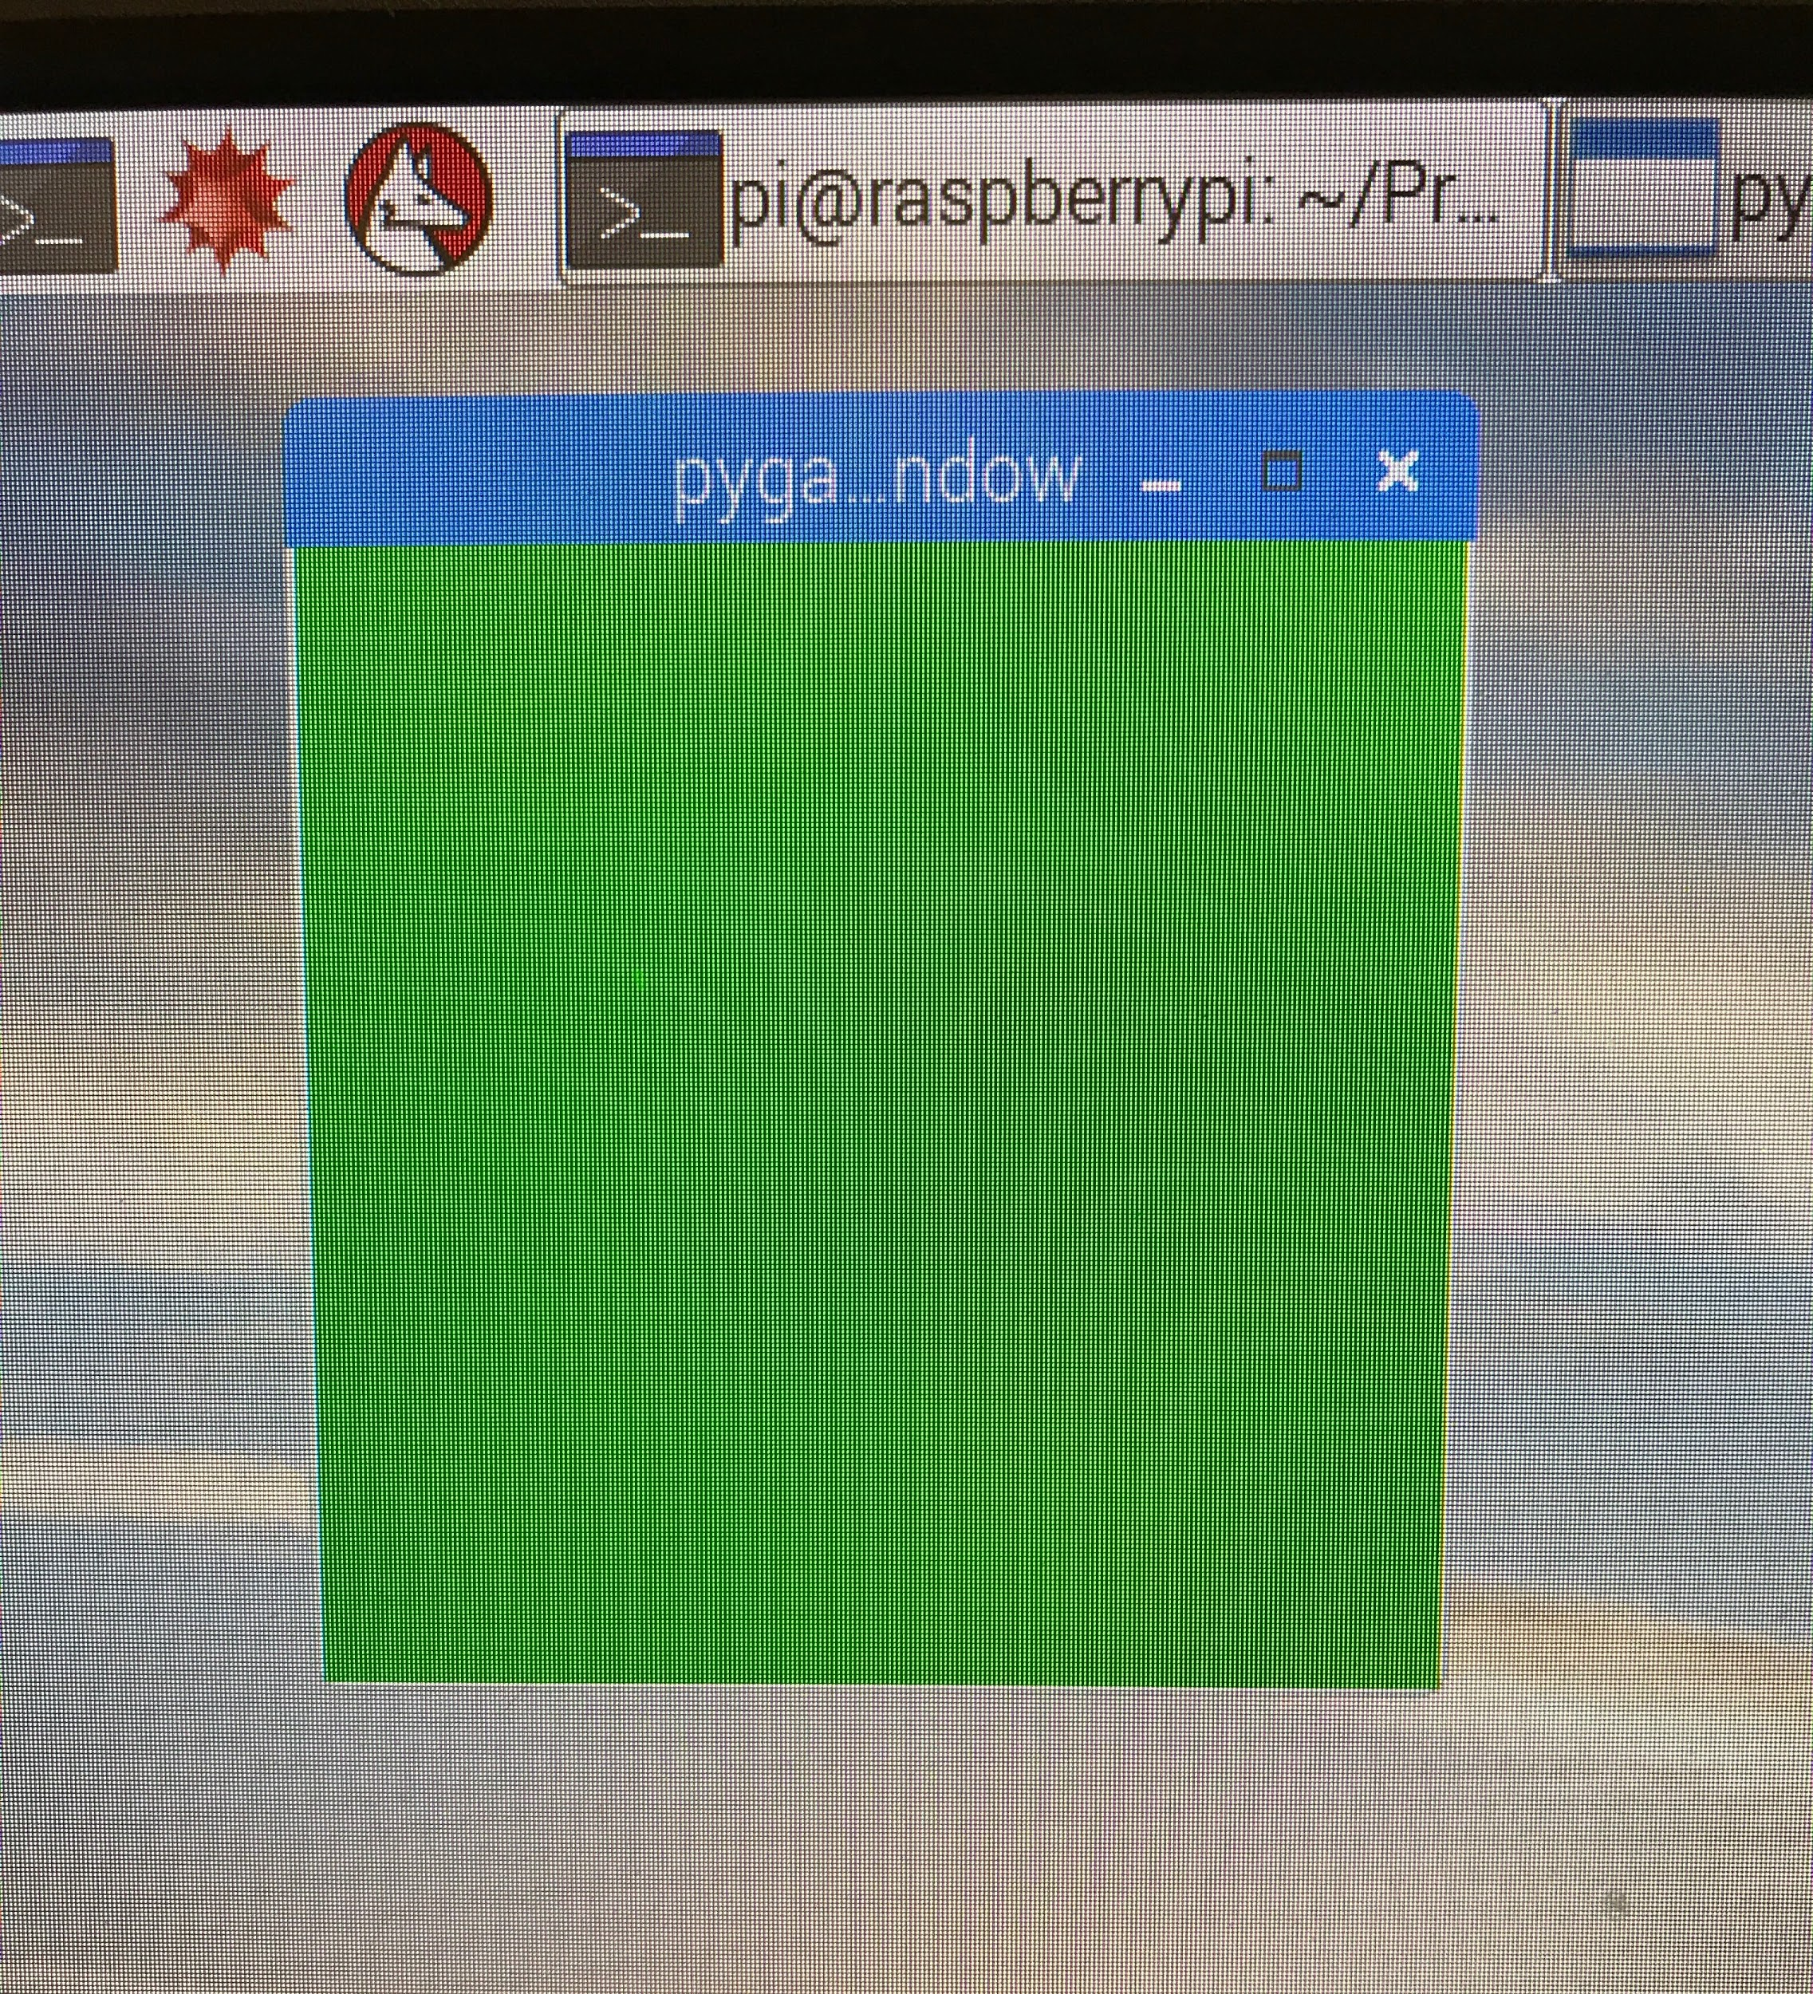
Sensors
Thermal Camera
Schematic
Output
Maximum/Minimum Values

Slide 11
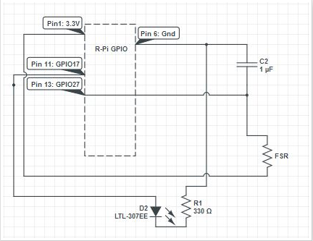
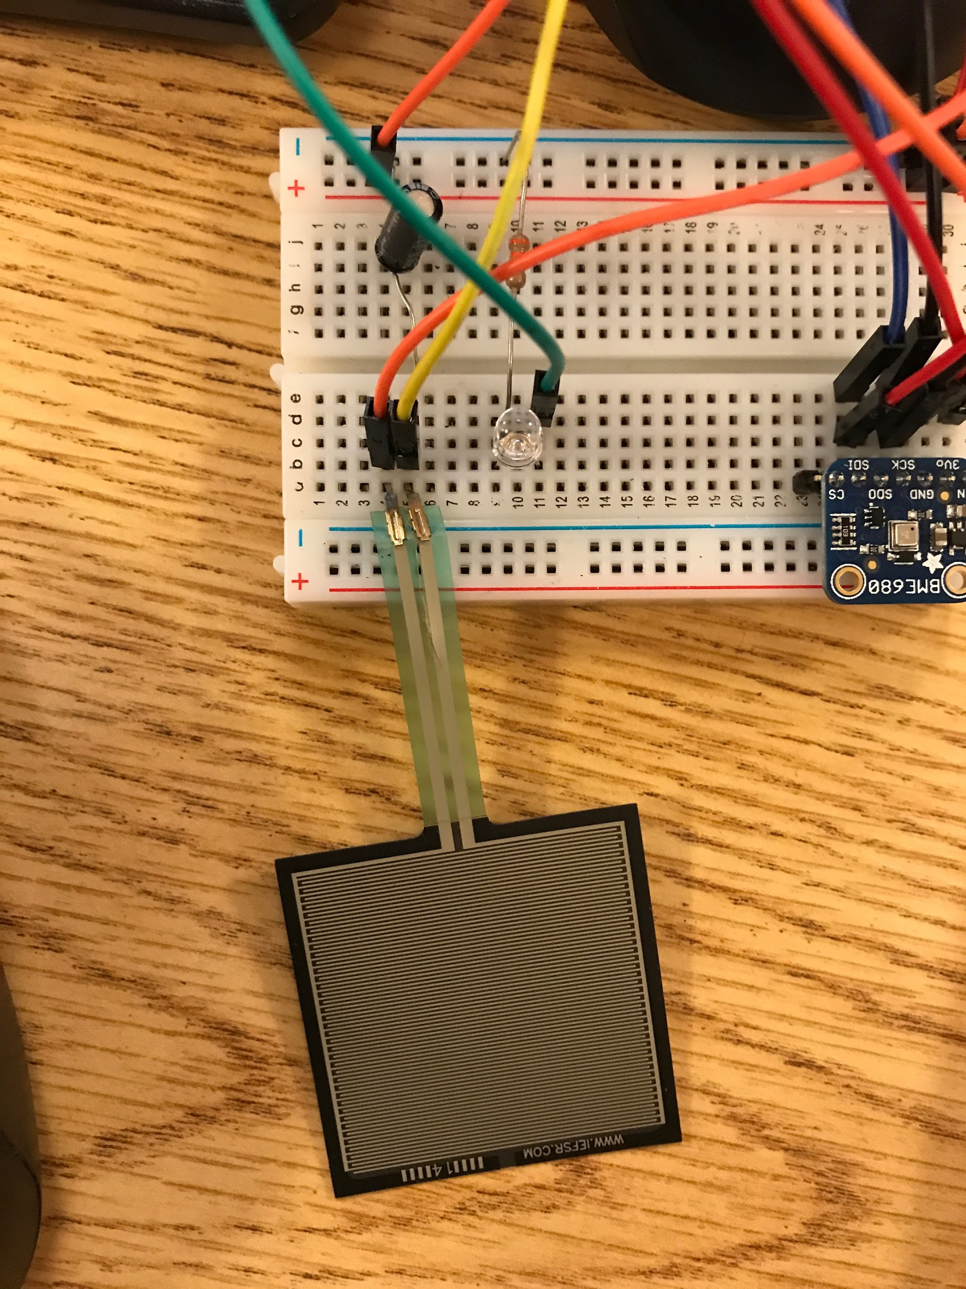
Sensors
Force Resistive Sensor
Schematic
Circuit

Slide 12
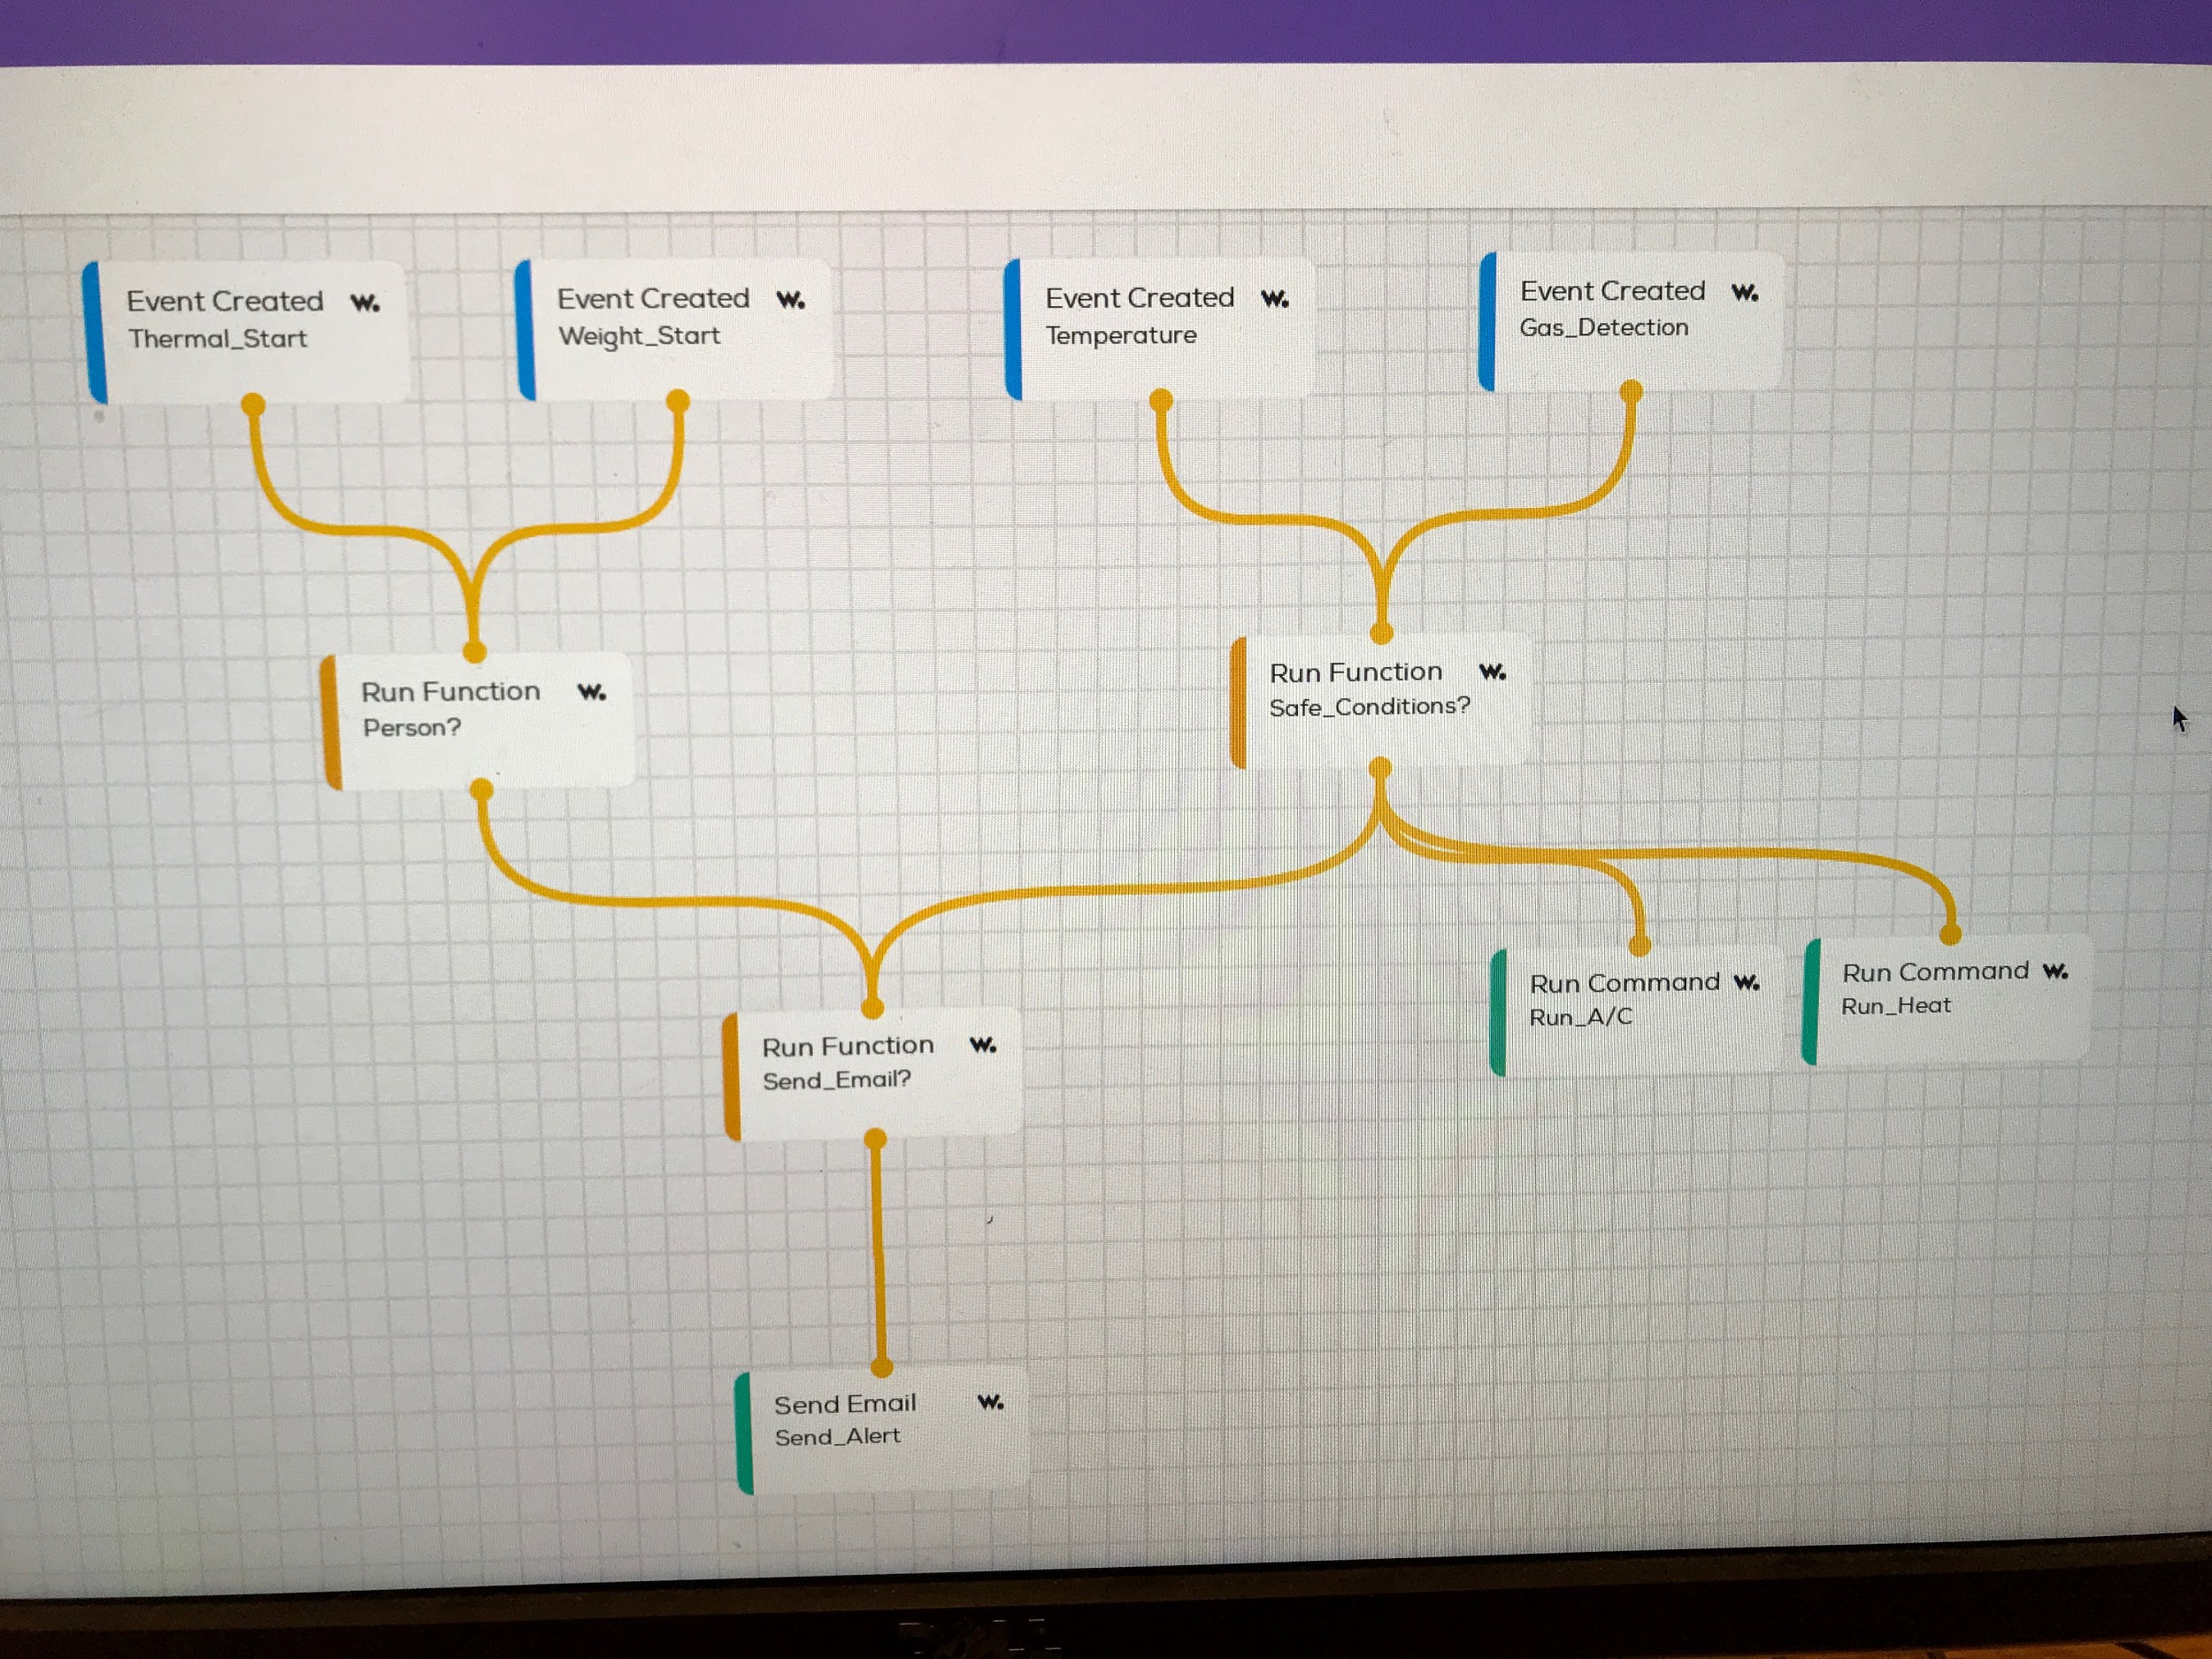
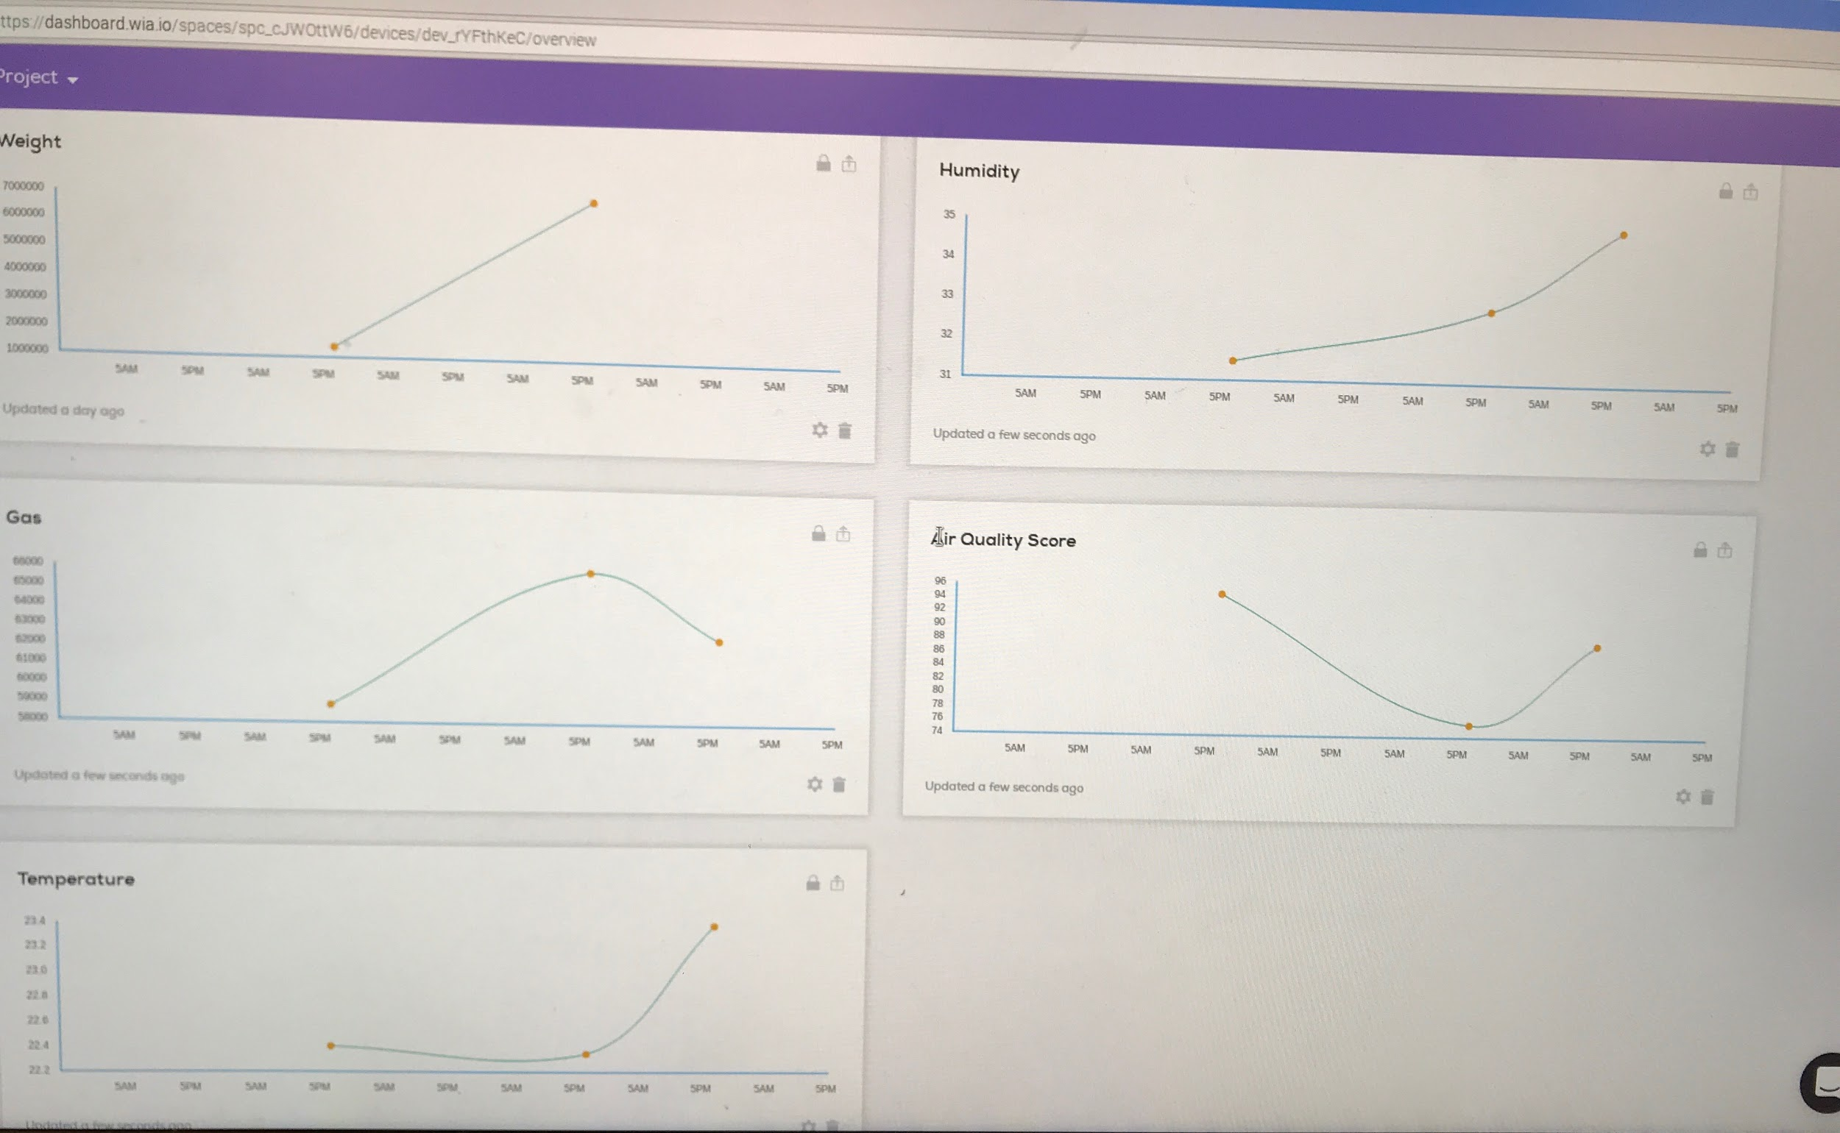
Wia Cloud Platform
Widgets
Events
Flow
Send Alert

Slide 13
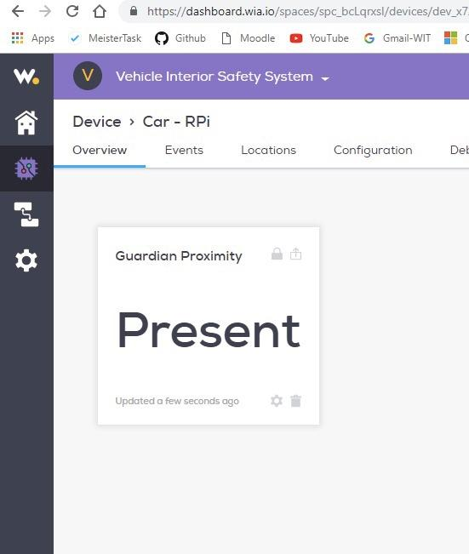
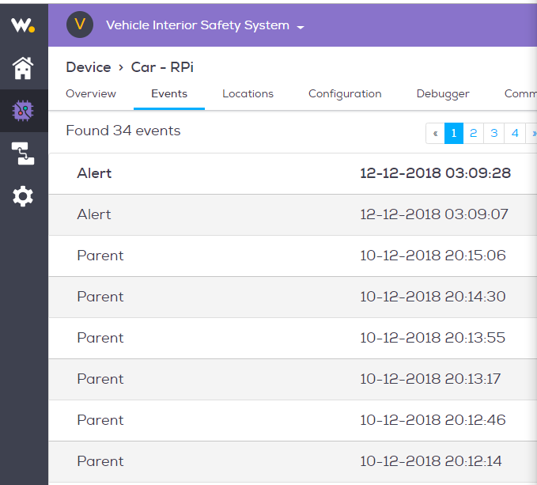
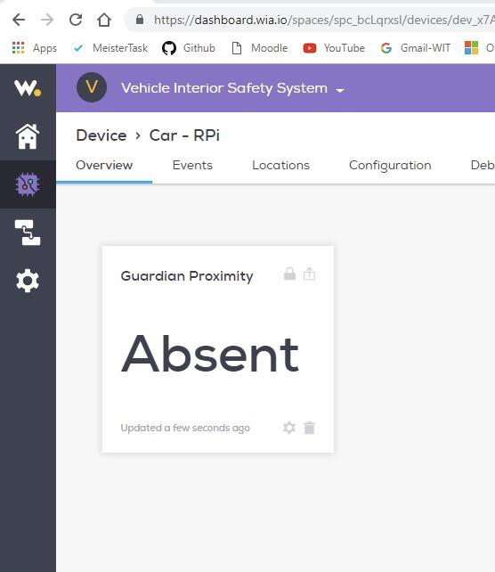
Notification Alerts - Wia

Slide 14

Device Prototype
https://drive.google.com/drive/folders/1eVO0eK2LO3d8G8UD_bFhKNIJae0kcVNS

Slide 15
Evaluation
Of Performance
Benchmark | Rating* | Score**
Correctly Identified Living Being | 3 | 6
Accurately Collected Cabin Temperature | 5 | 10
Accurately Collected Cabin Air Quality (CO2) | 3 | 6
Accurately Provided Location | 1 | 2
Accurately Sensed Guardian's Proximity | 3 | 6
Sent Alerts to Guardian/Emergency Services | 1 | 2
Turned ON/OFF A/C Appropriately | 2 | 4
Turned ON/OFF Heat Appropriately | 2 | 4
Stored Previously Collected Data | 5 | 10
False Readings/Alerts | 2 | 4
 | Total | 54
Rating*
1 : failure
2 : poor
3 : fair
4: sufficient
5: excellent
Score**
(Rating*) x 2

Slide 16

Challenges
Poor connections/wires
Wia Flows
Hard to Simulate conditions
Communication
Different components
Bluetooth

Slide 17

Thank You
Any Questions?

